Slide 1
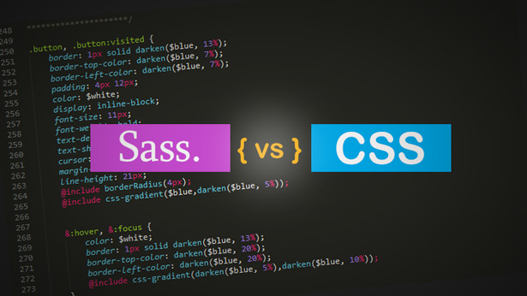
FOSS: SASS

Slide 2
INTRODUCTION OF TOOL
Sass stands for Syntactically Awesome Stylesheet
Sass is an extension to CSS
Sass is a CSS pre-processor
Sass reduces repetition of CSS and therefore saves time

Slide 3
LICENSES OF THE TOOL
Github link:
https://github.com/sass/node-sass/blob/master/LICENSE
A short and simple permissive license with conditions only requiring preservation of copyright and license notices. Licensed works, modifications, and larger works may be distributed under different terms and without source code.

Slide 4
ALTERNATIVES FOR THE TOOL
Node SASS
Stylus
Bootstrap
Animate CSS
Less

Slide 5
ADVANTAGES OF USING THE TOOL
Sass facilitates you to write clean, easy and less CSS in a programming construct.
It contains fewer codes so you can write CSS quicker.
It is more stable, powerful, and elegant because it is an extension of CSS

